Slide 1

Applications of Data Science
in Banking sector

Slide 2

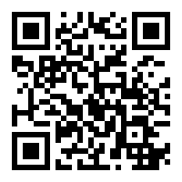
Avinash Mishra
Data Science Manager, SBI
Github: https://github.com/avinash-mishra
Stackoverflow: https://stackoverflow.com/users/2737885/avinash
Maintainer : https://datasciencetrend.netlify.app/
Speaker : International star conference (Japan), AI Planet, OdinSchool
Companies: Rakuten, Catalina Marketing Japan(CMJ), Infosys , Paradigmshift Inc
Hobbies: Badminton, Teaching
LinkedIn

Slide 3
Agenda
Data Science in BFSI
Tech stack for data scientist
Expectations and timelines
Data Scientist Career Path
Use case hands-on

Slide 4
What you have studied in Data Science ?

Slide 5
Data science in BFSI
Customer Base 48 crore
Population of US 33.19 crore
Huge Volume of Data
Transactions, UPI
Areas
Lending (PAPL, PABL, PACL, BNPL) Leads
Fraud (operational, transactional)
AML
HyperPersonalization
RecSys
Call center Analytics
Adhoc Analytics
Portfolio (Auto Loan, Home Loan, MSME, Agri)

Slide 6
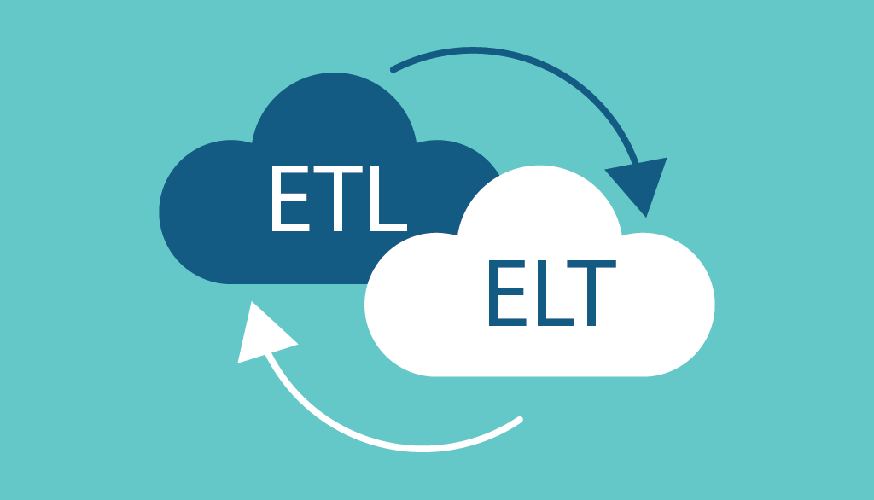












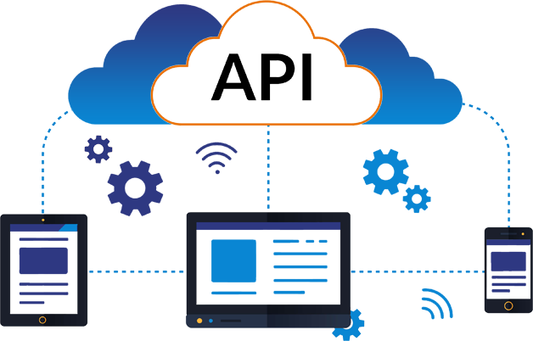
Tech stack for data scientist

Slide 7
Expectations
  Updated knowledge of Data science and domain (banking)
  Stakeholders engagements
  Story teller with prescriptive modeling
Timelines
Short term (2.5 months)
Medium term ( 6~8 months)
Long term ( 1 Year +)

Slide 8
Data Scientist Career Path in Banks
Data Translator/CM
Junior DS/AM
DS/DM
Senior DS/M
AGM/DGM
3-7 Y, IC
7-12 Y, SME, Team, cloud, MLOps
Head, CTDO, Business values
12-16 Y, compliance, governance, POV
2-3 Y, IC

Slide 9

Use Case Hands-on

Slide 10

Thank you

